Slide 1
Did Glaciers Cover the Planet?
An Inquiry into “Snowball Earth”
Chris Rackauckas
Advisor: Jim Walsh

Slide 2
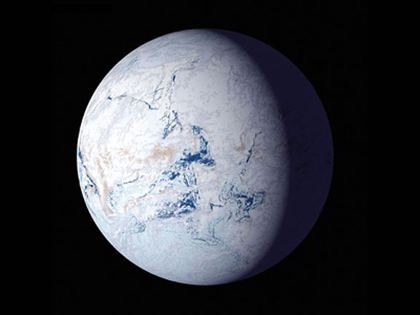
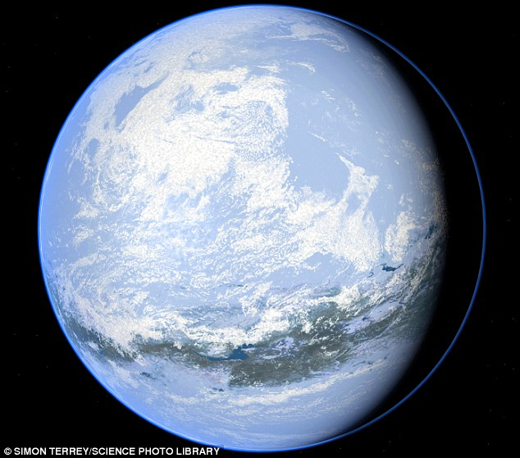
What is the nature of this glaciation?
Did the glaciers reach the equator or simply stop near the equator?
VS
Snowball Earth
Jormungand

Slide 3
Why would we consider the Jormungand Hypothesis?
Rocks that developed near the equator around 500 million years ago show evidence of glaciers
But photosynthetic eukaryotes survived the glaciation
But what would cause a Jormungand state to occur?
This is what we wish to address with mathematical models

Slide 4
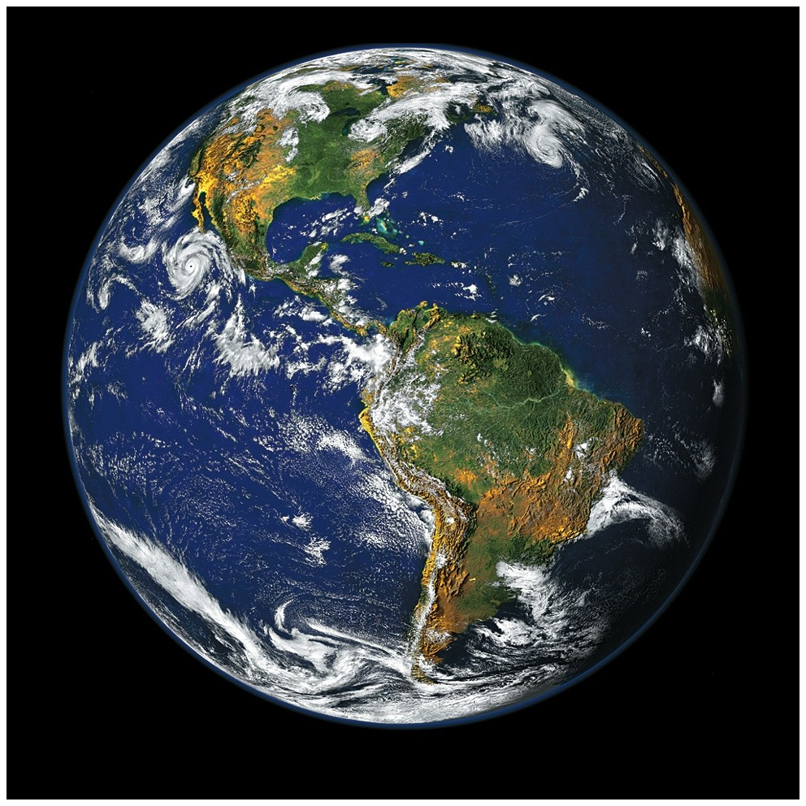
Formulating the Model, What Matters?
For our purposes:
  The Earth is a sphere
  The ice cap is a straight line at a well-defined latitude
  We can ignore seasons
  We can ignore changes in the Earth’s orbit
  We can ignore land
The Earth is a ball of water with more sunlight at the equator and an atmosphere.

Slide 5
Two Equations Define the Model
The change in temperature at a latitude = Energy in – Energy out
The change in the ice line = Temperature at the ice line – Melting temperature
Energy in we know from the physics of our orbit
Energy out we know from satellite data
We can use calculus and dynamical systems theory to solve for what we want!
  (Caution: Extreme math is held in the background. For the safety of our viewers, the math will be kept hidden.)

Slide 6
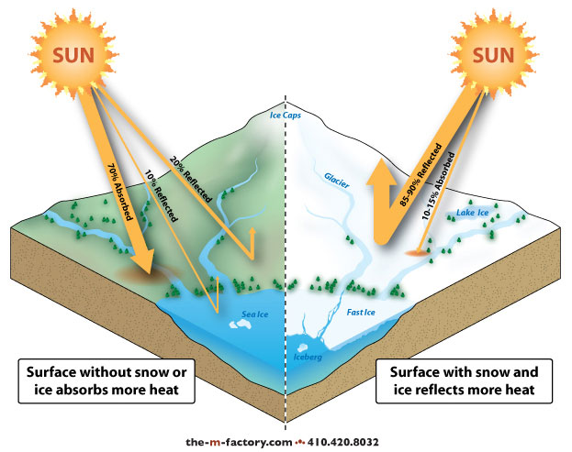
One Piece of Physics to Note
More light reflects off of the glaciers.
This changes our Energy in term.
Energy in = Energy from Sun x (1- % Reflected)

Slide 7
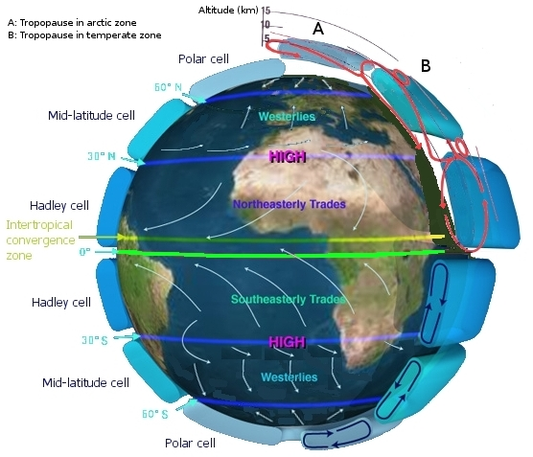
Lets add a new element
If you take the model as previously specified, you get a stable Snowball Earth state.
I wanted to understand what is required for a Jormungand state.
Snow covered glaciers reflect more than non-snow covered glaciers.
The Hadley Cells will cause glaciers near the equator to not have a snow covering

Slide 8
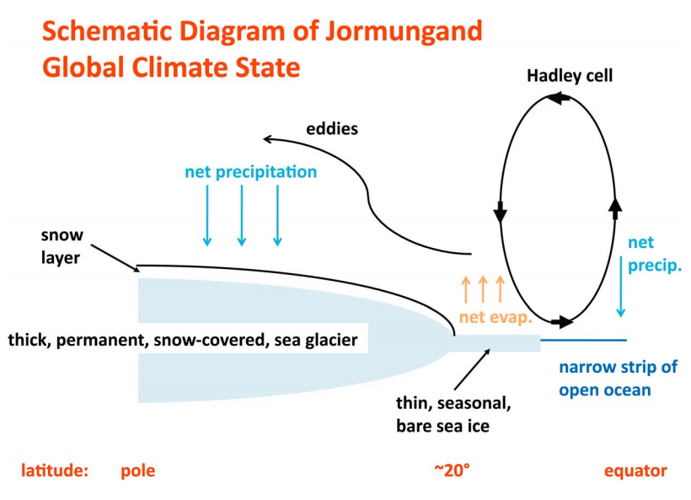
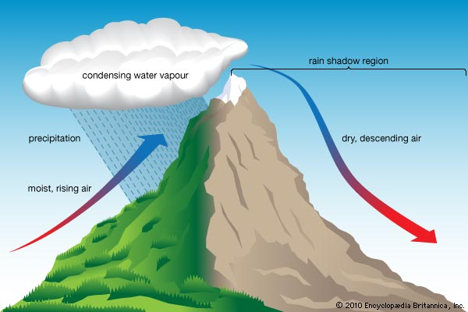
How do the Hadley Cells do this?

Slide 9
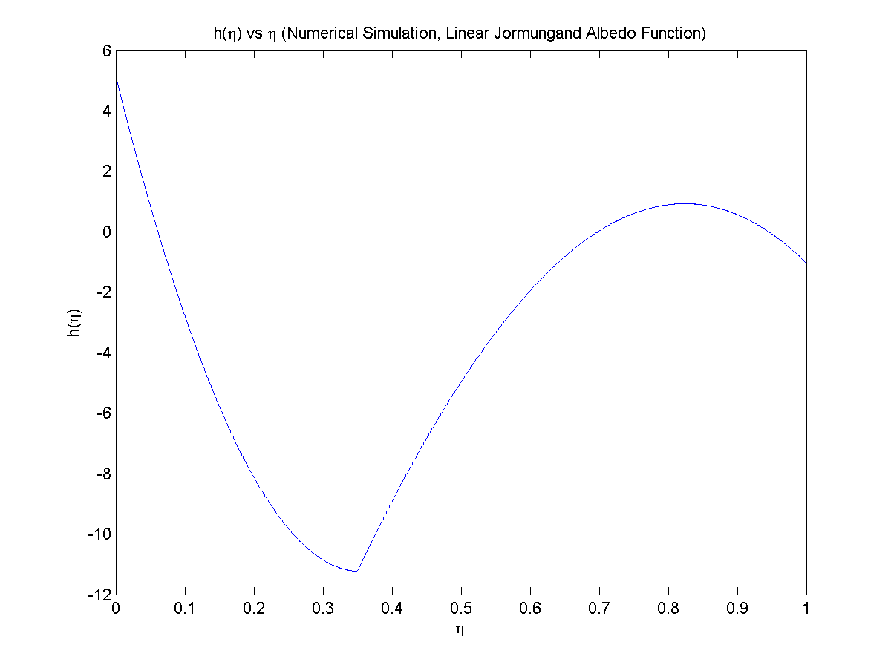

What’s the mathematical result of adding this to the model?
We can solve for a value h for the ice line at a given latitude η
  When h>0, the glaciers melt
  When h<0, the glaciers grow
Two stable equilibriums:
  One like the modern ice cap
  One like the Jormungand state!
Unstable
Stable

Slide 10
Conclusion
When adding the effect of the Hadley cells to the energy balance model, the stable large ice cap solution changes from a Snowball Earth solution to a Jormungand solution

